Slide 1
Tableau - Hotel Bookings
File created on: 2025-01-15 7:14:45 PM

Slide 2
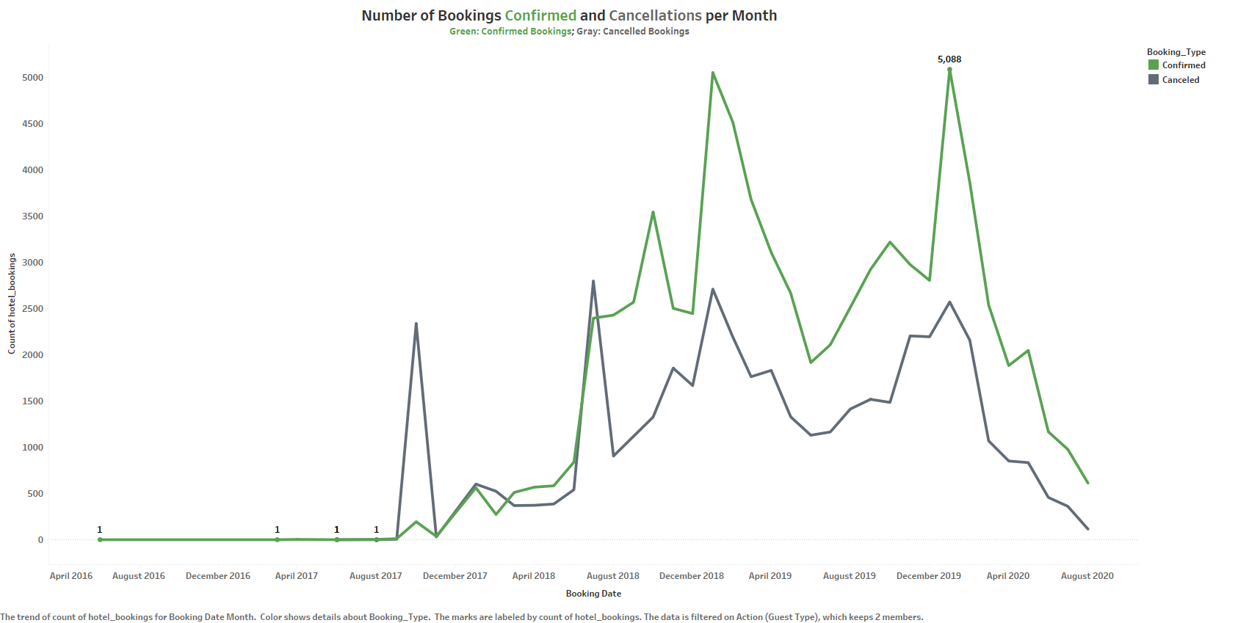

Slide 3
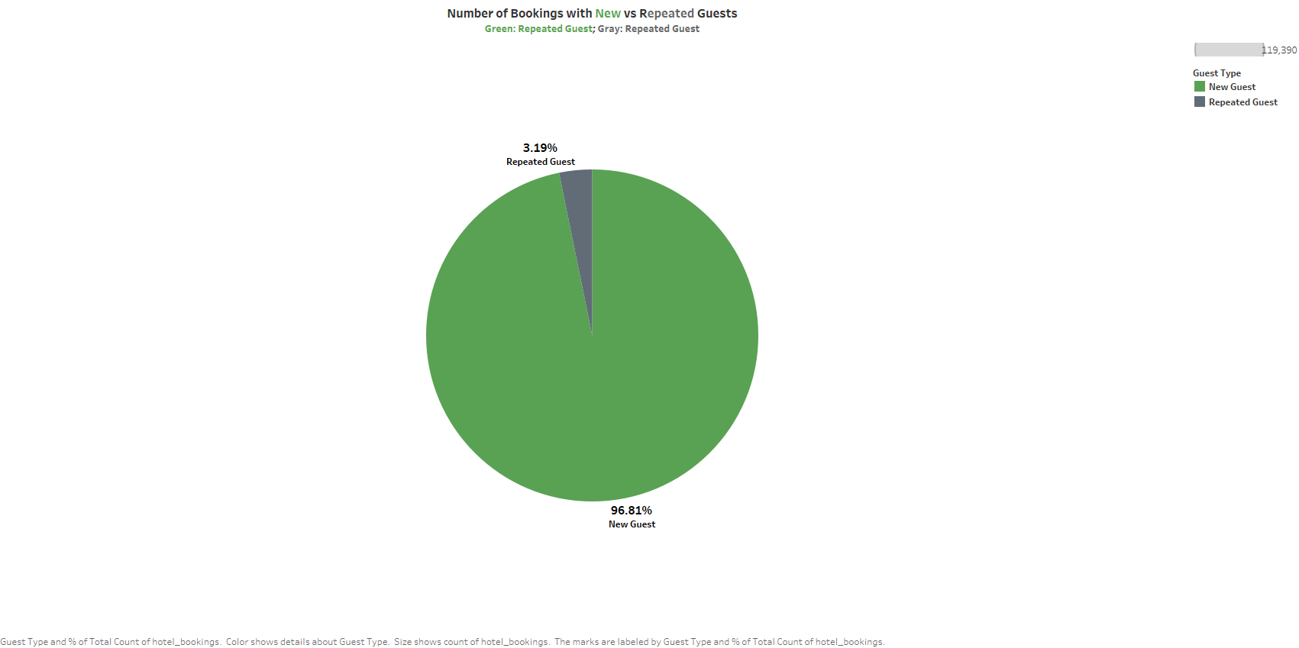

Slide 4
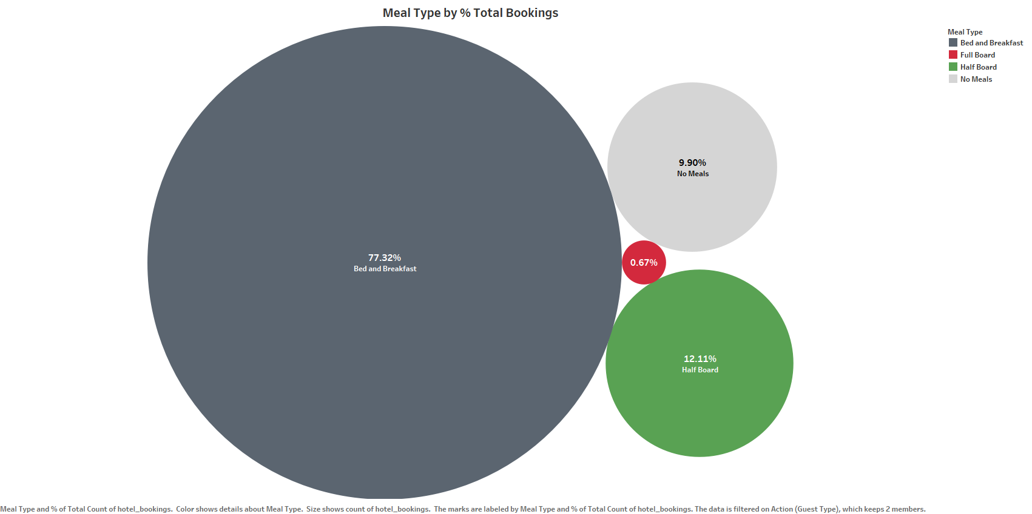

Slide 5
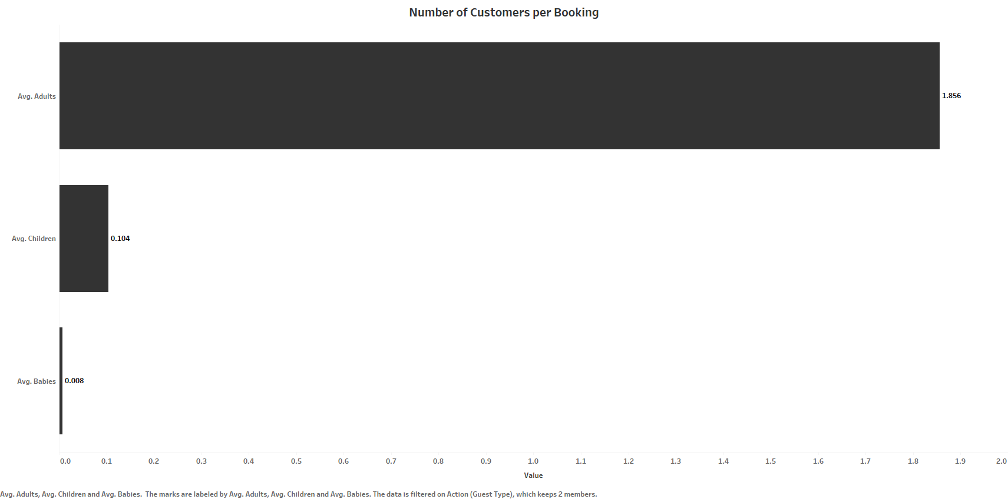

Slide 6
